Slide 1


Big Data Analytics PySpark
Presented By : Sneha Pawar.
Msc It Part I, Sem : II
Roll No : 11

Slide 2
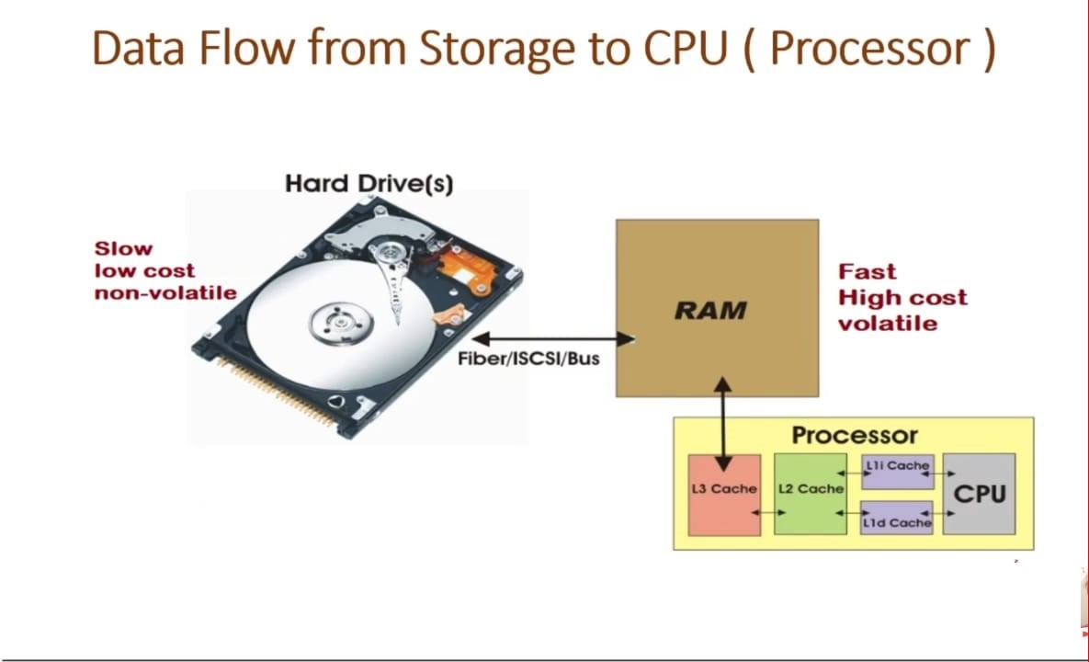
Msc IT – Part I – Sem II. Sub : BDA (PySpark. Sneha Pawar Roll No : 11)

Slide 3
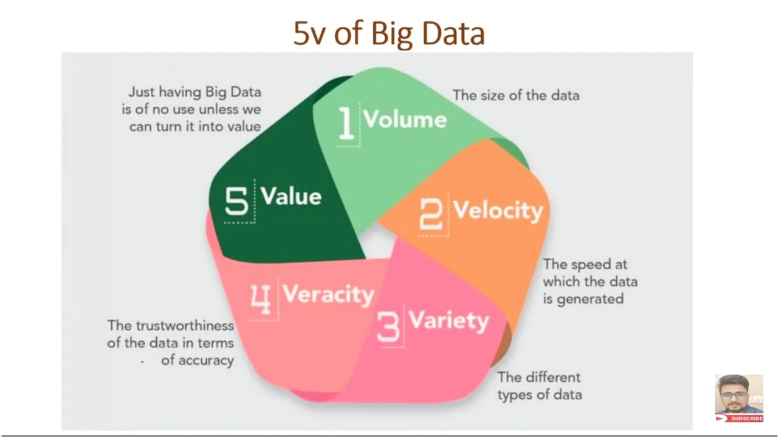
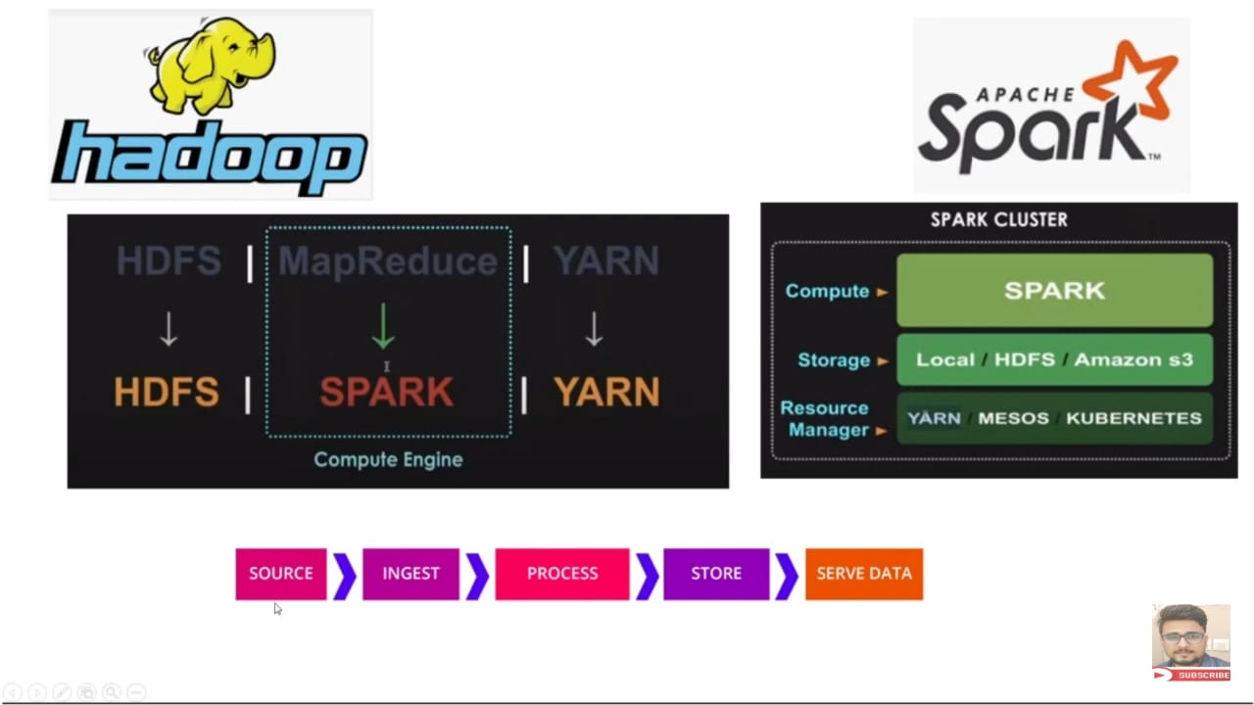
Msc IT – Part I – Sem II. Sub : BDA (PySpark. Sneha Pawar Roll No : 11)

Slide 4
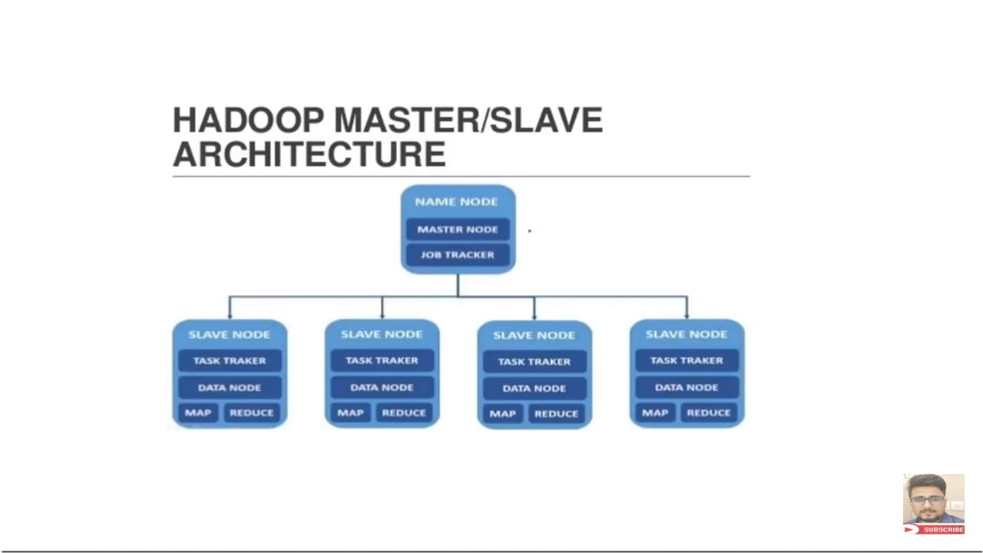
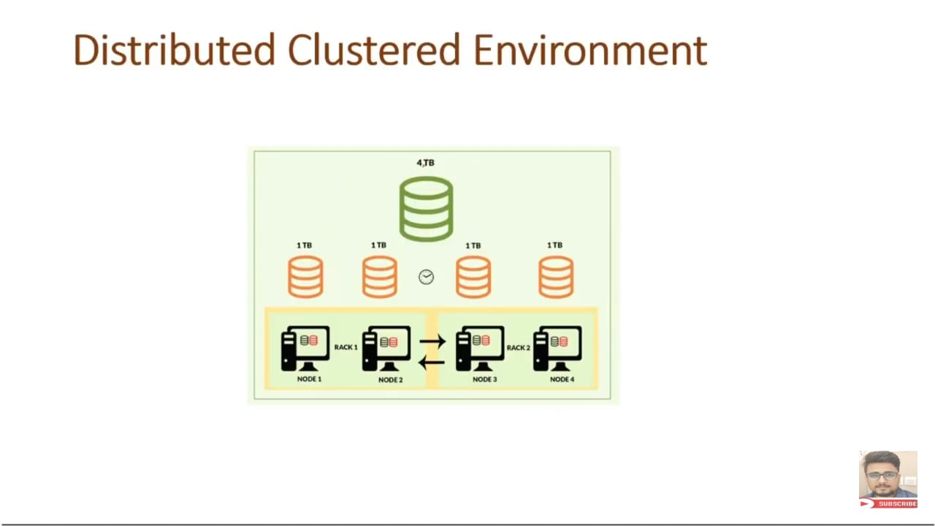
Msc IT – Part I – Sem II. Sub : BDA (PySpark. Sneha Pawar Roll No : 11)

Slide 5
What is PySpark ?
PySpark is an API of Apache Spark which is an open – Source, distributed processing system used for big data processing.
It was originally developed in Scala programming language at UC Berkely.
It was invented by the founder of DATABRICK company’s founder. And later it is donated to Apache Software Foundation.
It becomes opensource in 2010.
Spark is basically a computing engine.
To avail the facilities of Spark they have released python interface. And py4j is the library for that.
Msc IT – Part I – Sem II. Sub : BDA (PySpark. Sneha Pawar Roll No : 11)

Slide 6
The Spark has development API’s in Scala, JAVA, Python, R. & supports code reuse across multiple workloads in batch processing, interactive queries, real time analytics, machine learning and graph processing.
Apache Spark community released a tool, PySpark.
It doesn’t have its own file system like Hadoop HDFS, it supports most of all popular file systems like Hadoop Distributed File System (HDFS), Hbase, Cassandra, Amazon S3, Amazon Redshift, Couchbase, etc.
Msc IT – Part I – Sem II. Sub : BDA (PySpark. Sneha Pawar Roll No : 11)

Slide 7
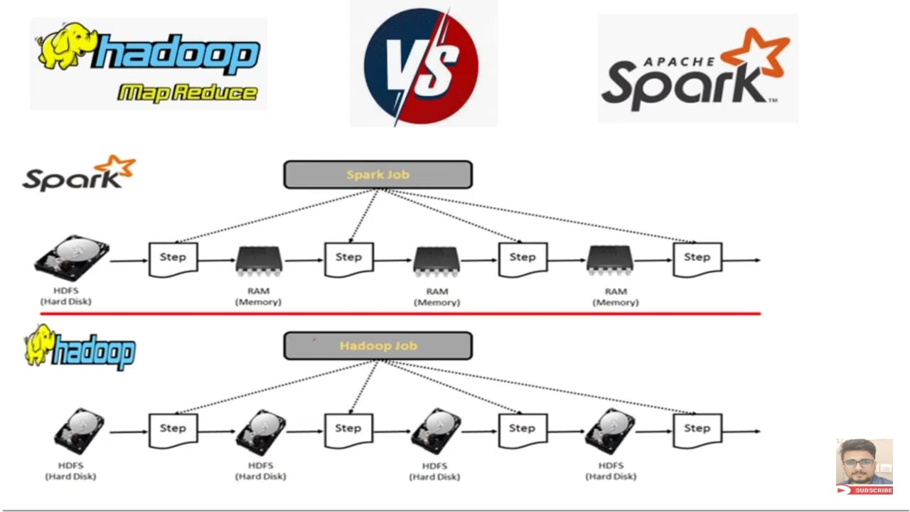
The Advantages of using Apache Spark :
1) It runs programs up to 100X faster than Hadoop MapReduce in memory, or 10X faster on disk. It claims because it does the processing in the main memory of the worker nodes and prevents unnecessary I/O operations.
Msc IT – Part I – Sem II. Sub : BDA (PySpark. Sneha Pawar Roll No : 11)

Slide 8
2) It supports in – memory computation, Lazy execution, Parallel Processing.
3) Apache Hadoop MapReduce was performing batch processing only and lacked a real-time processing feature. Spark does Batch and Real time processing both.
4) Spark can load data directly from disk, memory and other data storage technologies such as Amazon S3, Hadoop Distributed File System (HDFS), Hbase, Cassandra.
Msc IT – Part I – Sem II. Sub : BDA (PySpark. Sneha Pawar Roll No : 11)

Slide 9
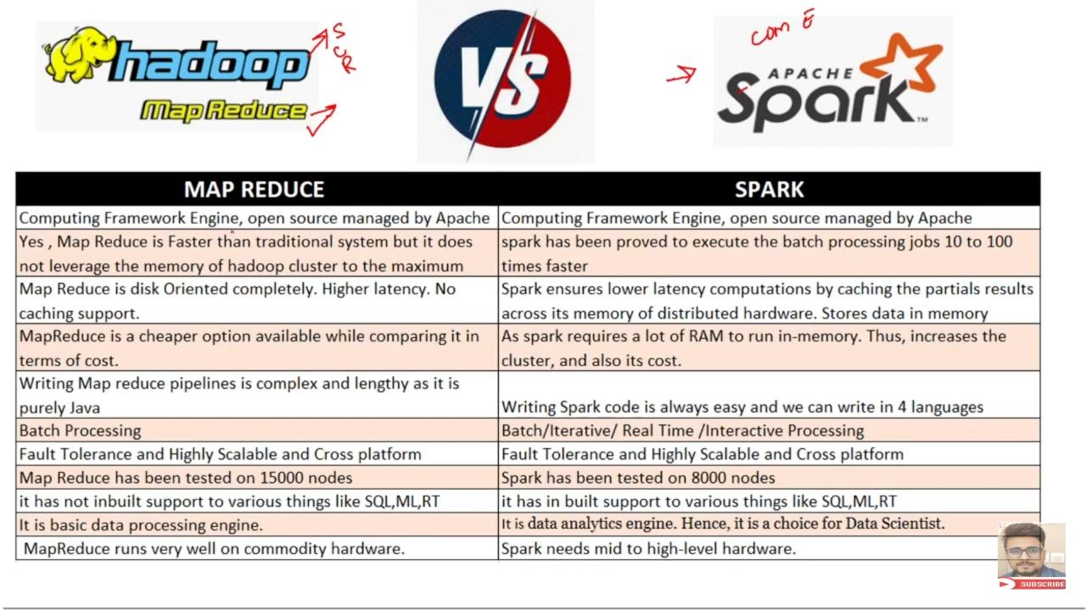
Msc IT – Part I – Sem II. Sub : BDA (PySpark. Sneha Pawar Roll No : 11)

Slide 10
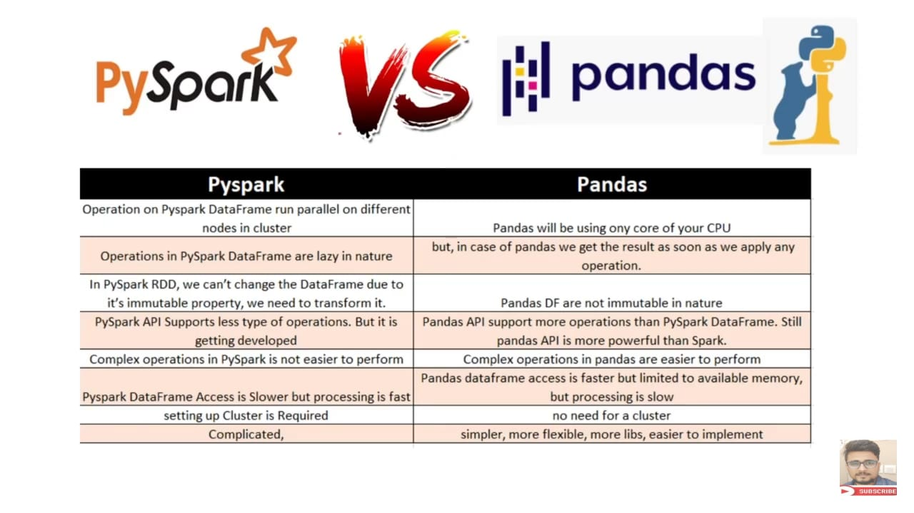
Msc IT – Part I – Sem II. Sub : BDA (PySpark. Sneha Pawar Roll No : 11)

Slide 11
Thank You !

